Slide 1


Slide 2


Quantifying the Costs of Charger Availability Uncertainty for Residents of Multi-Unit Dwellings
Aaron I. Rabinowitz Ph.D., Thomas Bradley Ph.D., Gil Tal Ph.D.

Slide 3
Section 1: Motivation

Slide 4
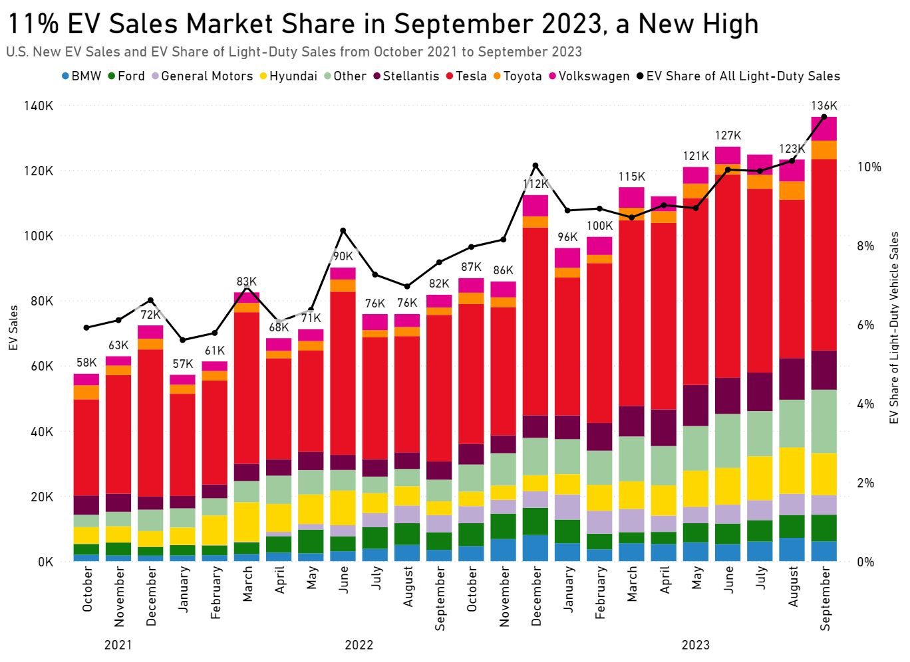
Motivation: PEV Sales
2023 was an interesting year for PEV sales
Significant milestones such as 10% US new car sales as 25% in california were hit for the first time
Rate of growth year-over-year was a little underwhelming
As adoption has gone up, discontinuance has remained constant(Reference 28)
The key dynamic of adoption theory is that the next adopter is always a harder sale than the last adopter
For how many people in the US is a BEV the best option? What are the implications of this?
https://www.atlasevhub.com/weekly-digest/one-million-evs-sold-through-september-2023/

Slide 5
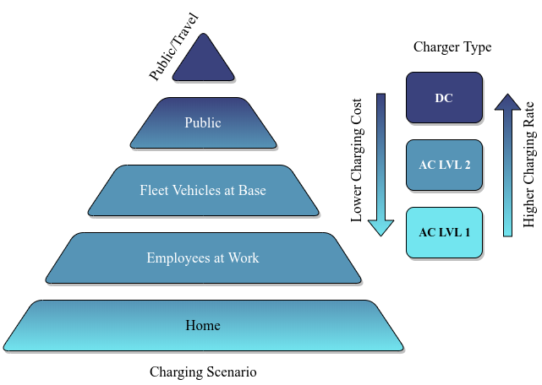
Motivation: The Charging Pyramid
PEVs require a different mental model of operation than ICEVs
The main difference is in energizing behavior - ICEV users almost always fuel at a gas station
For BEV users, the theory goes that they will follow the Charging Pyramid model
Here’s how that works ...

Slide 6
Motivation: The Charging Pyramid
Foundational slow charging:
At home or work
Cheap
You were going to be there anyway

Slide 7
Motivation: The Charging Pyramid
Supplemental fast charging:
On-the-go
Expensive
You diverted to charge
Foundational slow charging:
At home or work
Cheap
You were going to be there anyway

Slide 8
Motivation: The Charging Pyramid for MUD Residents
Residence Type | Percentage of US population¹ | Percentage of Residents with Actual Home Charging Access² | Percentage of Residents with Plausible Home Charging Access²
SUD (Attached / Detached) - Owned | 61.8% | 35% / 45% | 68% / 89%
SUD (Attached / Detached) - Rented | 12.9% | 15% / 28% | 47% / 70%
MUD 2-4 Unit - Owned | 1.2% | Not Provided | Not Provided
MUD 2-4 Unit - Rented | 2.38% | 9% | 26%
MUD 5+ Uni - Owned | 1.5% | Not Provided | Not Provided
MUD 5+ Unit - Rented | 12% | 7% - 14% | 19% - 29%
Non-Permanent Structure - Owned | 3.7% | 41% | 63%
Non-Permanent Structure - Rented | 1.5% | 29% | 51%
Americans rely on cars - we love houses
Single Unit Dwellings (SUDs) provide better access to charging than Multi Unit Dwellings (MUDs)
Home-Ownership provides better actual and potential access to charging
Caveat: Heterogeneity in dwelling categories
Caveat 2: Saturation not considered
¹ 2021 American Community Survey (ACS) Table B25003, US Census Bureau, 2021
² Ge, Yanbo, Christina Simeone, Andrew Duvall, and Eric Wood. 2021. There's No Place Like Home: Residential Parking, Electrical Access, and Implications for the Future of Electric Vehicle Charging Infrastructure. Golden, CO: National Renewable Energy Laboratory. NREL/TP-5400-81065. Data from Table 1 (Scenarios 2 and 5)

Slide 9

Motivation: Home Charging Access is a Scissor Issue
BEV charging is cheap, reliable, and convenient with access to home charging
Internal Combustion Engine Vehicles (ICEVs) are operationally identical for SUDs and MUDs
Everyone goes to a gas station and experience is determined by location
BEV charging is expensive, unreliable, and inconvenient without access to home charging

Slide 10
Motivation: Home Charging Access is a Scissor Issue
A new car is a big investment for many americans
People are reluctant to buy something for its upside ...
... if there is a reasonable chance they will be in position to suffer the downside

Slide 11
Motivation: Home Charging Access is a Scissor Issue
A new car is a big investment for many americans
People are reluctant to buy something for its upside ...
The downside risk of BEV ownership might scare off those who view MUD living as a real option - even if they live in a SUD
... if there is a reasonable chance they will be in position to suffer the downside

Slide 12






Motivation: Home Charging Access is a Scissor Issue
In the US, individual BEV buyers are disproportionately:
Tech-Positive
Male
Wealthy
Educated
Middle-Aged
All of which are high-cost-tolerance and high-risk-tolerance groups
(references 9 - 13)

Slide 13
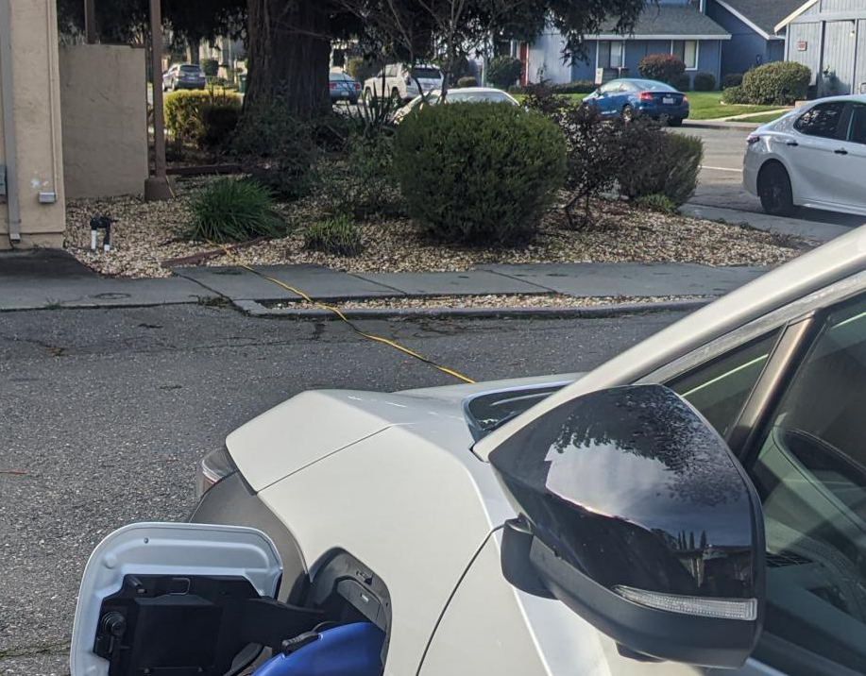
Motivation: Home Charging Access is a Scissor
MUD BEV ownership sometimes requires innovator behavior

Slide 14
Motivation: Research Questions and Hypotheses
RQ1: What impact does long-dwell charger availability rate have on BEV user inconvenience?
H1: Low charger availability rates negatively impact BEV user experience by forcing BEV users to maintain higher charge levels and opt for inconvenient charge events
RQ2: What impact would a charger-availability scheduling system have on BEV user inconvenience for BEV users who depend on shared chargers?
H2: Charger-availability scheduling systems reduce BEV user experience for BEV users who rely on shared chargers by providing information which can be used to make better plans

Slide 15
Section 2: Methods

Slide 16
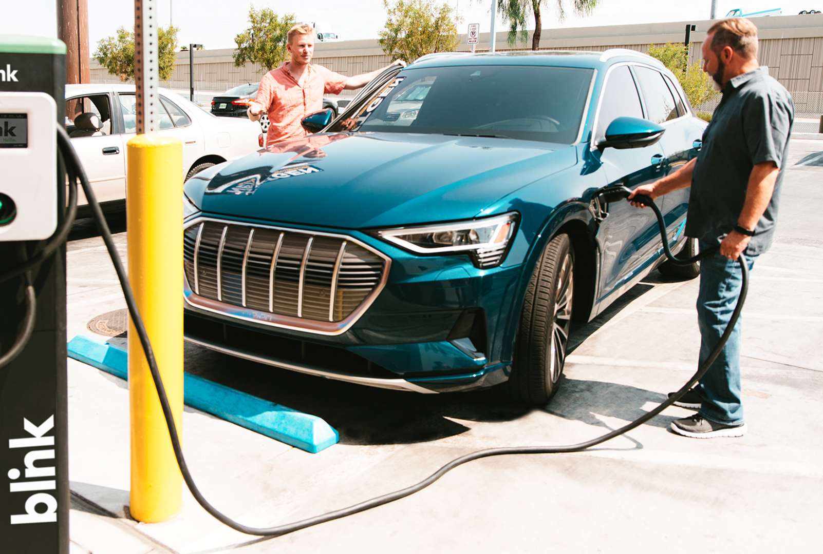
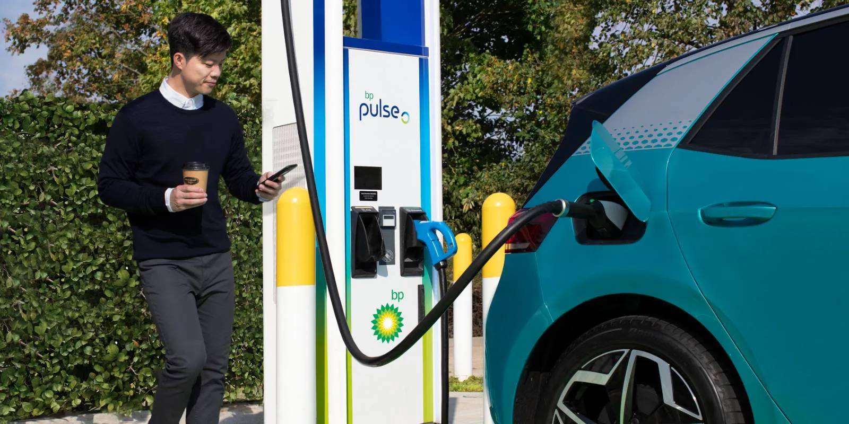
Quantifying Charging Inconvenience
Not all charge events are created equal:
If you have to ammend your plans to charge you feel inconvenienced
I wish we were doing literally anything else right now
We should’ve taken my car bro
I’m soooo bored

Slide 17
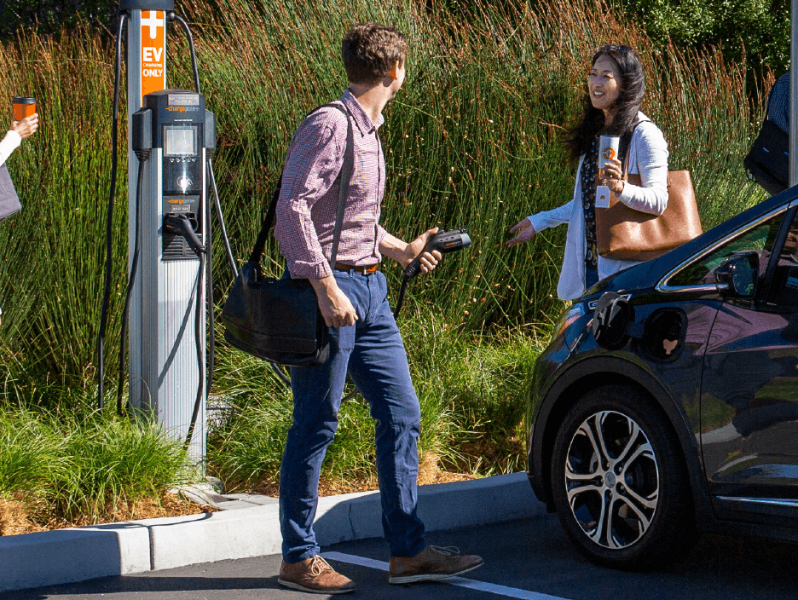
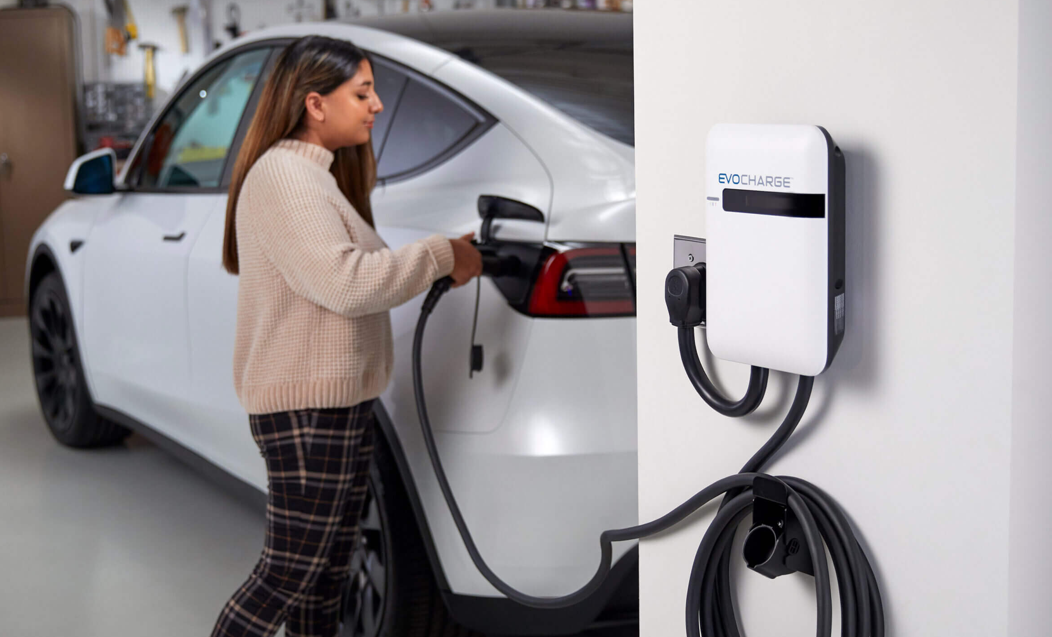
Quantifying Charging Inconvenience
Not all charge events are created equal:
If you don’t have to ammend your plans to charge you don’t feel inconvenienced - regardless of the charge event duration
Aren’t you glad they installed these chargers?
Yeah, it’s awesome!

Slide 18
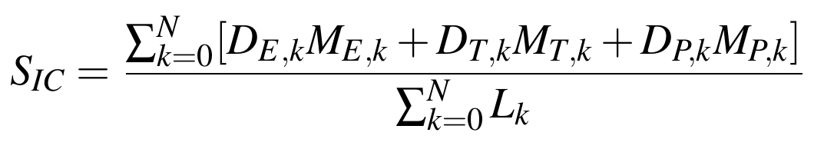
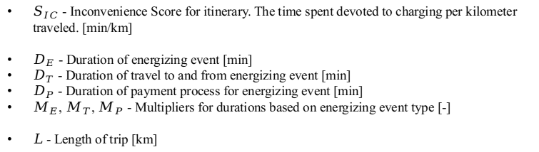
Inconvenience Score
$S_{IC}$ - Inconvenience Score for itinerary. The time spent devoted to charging per kilometer traveled. [min/km]
$D_{E}$ - Duration of energizing event [min]
$D_{T}$ - Duration of travel to and from energizing event [min]
$D_{P}$ - Duration of payment process for energizing event [min]
$M_{E}$, $M_{T}$, $M_{P}$ - Multipliers for durations based on energizing event type [-]
$L$ - Length of trip [km]

Slide 19
Inconvenience Score
$S_{IC}$ - Inconvenience Score for itinerary. The time spent devoted to charging per kilometer traveled. [min/km]
$D_{E}$ - Duration of energizing event [min]
$D_{T}$ - Duration of travel to and from energizing event [min]
$D_{P}$ - Duration of payment process for energizing event [min]
$M_{E}$, $M_{T}$, $M_{P}$ - Multipliers for durations based on energizing event type [-]
$L$ - Length of trip [km]

Slide 20
Inconvenience Score
$S_{IC}$ - Inconvenience Score for itinerary. The time spent devoted to charging per kilometer traveled. [min/km]
$D_{E}$ - Duration of energizing event [min]
$D_{T}$ - Duration of travel to and from energizing event [min]
$D_{P}$ - Duration of payment process for energizing event [min]
$M_{E}$, $M_{T}$, $M_{P}$ - Multipliers for durations based on energizing event type [-]
$L$ - Length of trip [km]

Slide 21
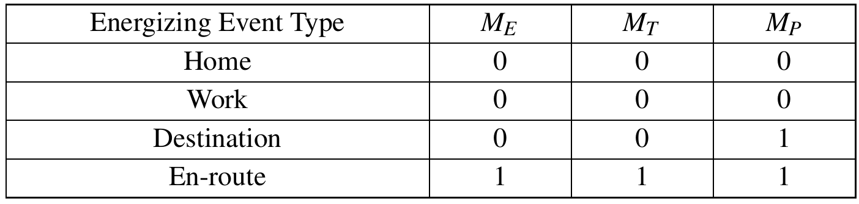
Inconvenience Score

Slide 22
Inconvenience Score

Slide 23
Inconvenience Score

Slide 24
Computing Inconvenience Score (Deterministic)
Lemma 1: The characteristic inconvenience for a given itinerary is the minimum inconvenience
Drivers may optimize around a different objective (i.e. energy cost)
Drivers may fail to fully optimize around their chosen objective
Policies and investments which lower minimum inconvenience enable better experience in any event
Lemma 2: Drivers will minimize in convenience by opting for less inconvenient charging events where possible before reducing driving
Drivers for whom inconvenience is limiting driving may increase driving if they are able to charge in a more convenient manner - this still represents utility gained

Slide 25
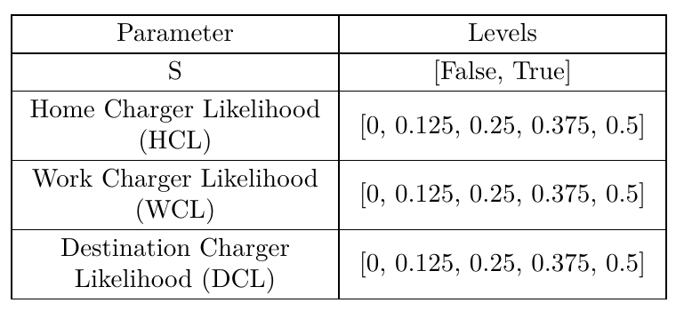
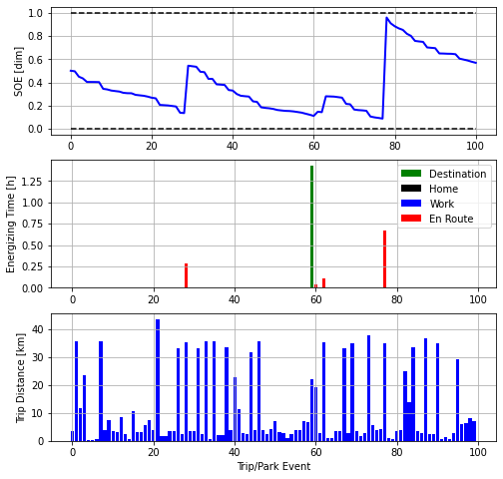
Computing Inconvenience Score (Deterministic)
Define charger availability likelihoods
Compute Optimal Charge Schedule (OCS) to minimize Inconvenience Score
Apply to MUD¹ NHTS Itinerary
¹ Itineraries selected for high density, high rentership areas

Slide 26
Computing Inconvenience Score (Stochastic)
But what if charger availability is uncertain?
For example: a MUD has 50 parking spaces but only 3 chargers - how does this influence the ability of residents to minimize inconveniece?
The optimization can still be performed but with imperfect (stochastic) information - but the stochastic optimal solution will usually be higher cost than the perfect information (deterministic) solution
The cost of the stochastic optimal solution considering multiple scenarios is the Expected Cost
The mean cost of the deterministic optimal solution for each scenario is the Mean Cost
Value-of-Information = Expected Cost - Mean Cost

Slide 27
Computing Inconvenience Score (Stochastic)
Define charger availability likelihoods
Compute Optimal Charge Schedule (OCS) to minimize Inconvenience Score
Apply to MUD¹ NHTS Itineraries
¹ Itineraries selected for high density, high rentership areas

Slide 28
Section 3: Experiment

Slide 29
Experiment: Hypotheses
H1: Low charger availability rates negatively impact BEV user experience by forcing BEV users to maintain higher charge levels and opt for inconvenient charge events
H2: Charger-availability scheduling systems reduce BEV user experience for BEV users who rely on shared chargers by providing information which can be used to make better plans

Slide 30
Experimental design
A full-factorial experiment was performed on the following factors:
S - Boolean for stochastic optimization (True) or deterministic optimization (False)
HCL - Likelihood of an AC L2 charger being available at home for a given home dwell
WCL - Likelihood of an AC L2 charger being available at home for a given work dwell
DCL - Likelihood of an AC L2 charger being available at home for a given destination (store, restaurant, gym) dwell

Slide 31

Data Used
In each case all selected itineraries were simulated on 5 randomly generated charger availability scenarios subject to HCL, WCL, and DCL
Itineraries were taken from down-sampled from 2017 NHTS. Data were selected for the following criteria:
Only driver trips counted (PERSONID = WHODROVE)
Only trips taken with household primary vehicles (VEHID ≤ 2)
High population denisty home locations (OTRESDN ≥ 70,000)
High rentership home locations (OBHTRNT ≥ 70)
At least one trip to work in itinerary (WHYTO = 3)

Slide 32
Section 4: Results / Discussion

Slide 33
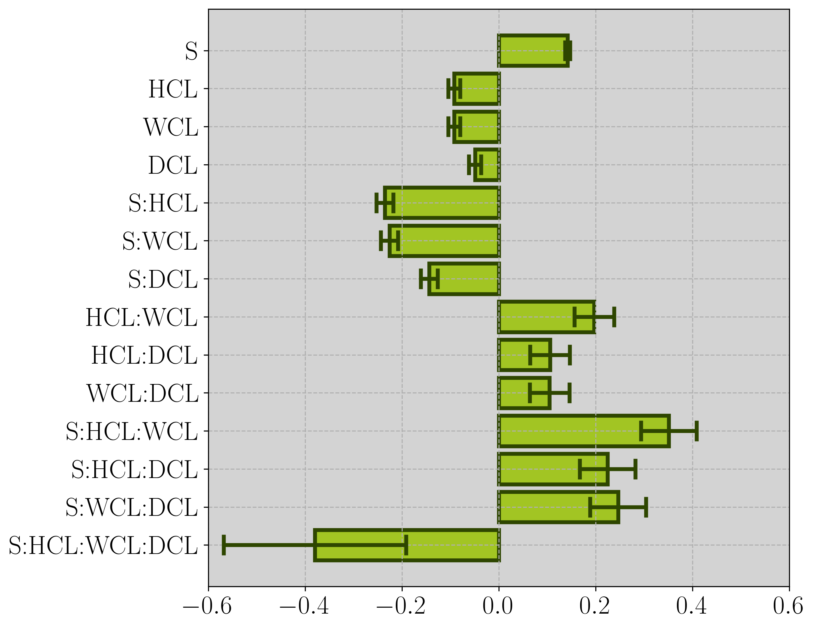
Significant Factors from Regression Analysis of Experiment Results
Linear regression analysis was conducted based on the results of the full-factorial regression with S, HCL, WCL, DCL, and all interactions to find significant terms
Increased charger availability leads to significant reduction in inconvenience score
Relationships between types of charger availability are subtractive
S (value-of-information) was significant along with all S-interactions
S alone accounts for 14.2% of the results
Relationship between S and other factors is additive

Slide 34
Significant Factors from Regression Analysis of Experiment Results
Linear regression analysis was conducted based on the results of the full-factorial regression with S, HCL, WCL, DCL, and all interactions to find significant terms
Increased charger availability leads to significant reduction in inconvenience score
Relationships between types of charger availability are subtractive
S (value-of-information) was significant along with all S-interactions
S alone accounts for 14.2% of the results
Relationship between S and other factors is additive

Slide 35
Significant Factors from Regression Analysis of Experiment Results
Linear regression analysis was conducted based on the results of the full-factorial regression with S, HCL, WCL, DCL, and all interactions to find significant terms
Increased charger availability leads to significant reduction in inconvenience score
Relationships between types of charger availability are subtractive
S (value-of-information) was significant along with all S-interactions
S alone accounts for 14.2% of the results
Relationship between S and other factors is additive

Slide 36
Discussion: Value-of-Information and Policy Implications
Fewer shared chargers per vehicle means a more inconvenient experience for those who rely on them.
Those most likely to be impacted are those living in MUDs, especially in older buildings
Similar methodology in previous study shows that home/work can allow for convenience parity with ICEVs, lack thereof can result in up to a 10x increase in inconvenience (Reference 36)
This issue is compounded if availability is unscheduled - uncertain availability will force users to, at the very least, keep a higher charge level and opt for more inconvenient charging events
Not modeled in this study but unregulated access to a scarce shared resource can lead to all manner of antisocial behavior and interpersonal strife
So there is a need to design policy to increase access to AC L2 charging in MUDs but such policy should also encourage scheduled access

Slide 37
Author Contact Information
Aaron I. Rabinowitz Ph.D.
Post-Doctoral Researcher
EV Research Center
Institute of Transportation Studies
University of California, Davis
email: arabinowitz@ucdavis.edu
Corresponding Author
Gil Tal Ph.D.
Director,
Director, STEPS+
Professor, Environmental Science and Policy
EV Research Center
Institute of Transportation Studies
University of California, Davis
email: gtal@ucdavis.edu
Thomas Bradley Ph.D.
Department Head
Woodward Distinguished Professor
Department of Systems Engineering
Colorado State University
email: thomas.bradley@colostate.edu

Slide 38
Thank You

Slide 39
Minimizing Inconvenience

